Slide 1


BrainPath Architecture & Implementation
Relational Database Design and Backend Pipeline
Group 9

Slide 2


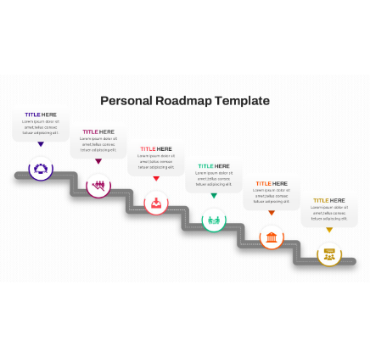
PROJECT ROADMAP & DELIVERABLES
This phase focuses on translating academic requirements into a scalable Full-Stack architecture.
Data Elements: Identifying unique entities and user attributes.
Relational Modeling: Blueprinting the system in 3rd Normal Form.
API Implementation: Building the Node.js Express server logic.
State Hydration: Linking database records to the React frontend.

Slide 3



1. DATA ELEMENTS & CORE ENTITIES
User Credentials
Student Metrics
Curriculum Data
Secure identity variables including encrypted password hashes and administrative roles.
Performance vectors like cumulative study hours, completion rates, and daily streaks.
Course artifacts, module keys, and lesson-level tracking parameters.
Event Metadata
Engagement Logs
Temporal events including quizzes, lectures, and task-specific deadlines.
User activity distributions mapped across the weekly calendar for trend analysis.

Slide 4

2. CONCEPTUAL RELATIONAL MODELING
Normalization & Performance
3NF Compliance: We architected the schema following 3rd Normal Form rules to eliminate data redundancy and ensure transactional integrity.
Decoupled Tables: Volatile metrics (e.g., login streaks) are separated from core user info to optimize query speeds and storage efficiency.
Access Control: Logic-level separation of Student and Instructor roles for secure dashboard routing.

Slide 5
SYSTEM RELATIONSHIP LOGIC
Relationship Path | Cardinality | Engineering Context
Users → Students | 1 : (0...1) | Mandatory unique profile link per account.
Instructors → Courses | 1 : N | One primary owner for multiple learning modules.
Students ↔ Courses | M : N | Resolved via specialized Enrollment junction tables.
Courses → Assessment | 1 : N | Sequential quizzes tied to a singular course ID.
Content → Adaptive Rules | 1 : N | Data artifacts processed by recommendation engines.
* Standard Crow's Foot notation was used to establish these relational constraints.

Slide 6

3. ER ARCHITECTURE & IDENTITY
UUID Identity Strategy: We utilize Universally Unique Identifiers (UUID) for primary keys instead of integers to enhance security and prevent record prediction.
Referential Integrity: Implemented ON DELETE CASCADE for profile metrics to ensure automatic cleanup of dependent student data.
Junction Tables: Efficient mapping of student progress across courses using high-speed modules lookup tables.

Slide 7
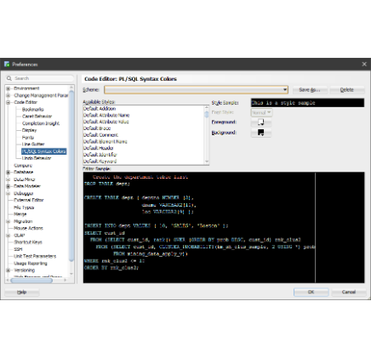
4. PHYSICAL DATABASE EXECUTION
Safe Schema Engineering
Enum Constrained Types: Deployed custom enumerated types directly in the DB engine to prevent illegal data entry at the source.
Safe Migrations: Developed idempotent SQL scripts (IF NOT EXISTS) to allow continuous updates without data loss.
Record Bootstrapping: Automated procedures to initialize study metrics immediately upon user registration.

Slide 8
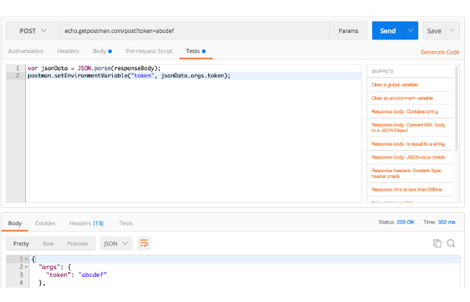
5. BACKEND PIPELINE & EXPRESS APIS
API Logic & Security
Connection Pooling: Configured pg-pool to manage database connections efficiently under heavy user load.
Authentication Guards: Middleware layer decrypts Bearer tokens to verify user permissions before data access.
JSON Payloads: Optimized API endpoints aggregate complex data (profile, charts, events) into single, predictable response objects.

Slide 9

6. FULL-STACK INTEGRATION
Dynamic Hydration: Connected the React Dashboard to Backend endpoints using standardized async request patterns.
Type-Safe Rendering: The UI layer is synchronized with the DB schema, ensuring charts and tables display real-time data metrics.
Asynchronous UX: Implemented visual loading states and error boundaries to handle data fetching latency gracefully.
BrainPath is now a fully data-driven educational platform.

